Slide 1

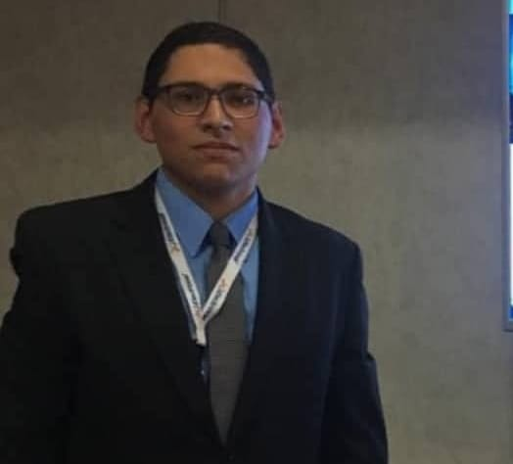
SELF DRIVING CARS UNA APROXIMACION END TO END DEVELOPMENT
Napoleón Alcides Pérez Arteaga | LinkedIn
napoleon2008@ieee.org

Slide 2
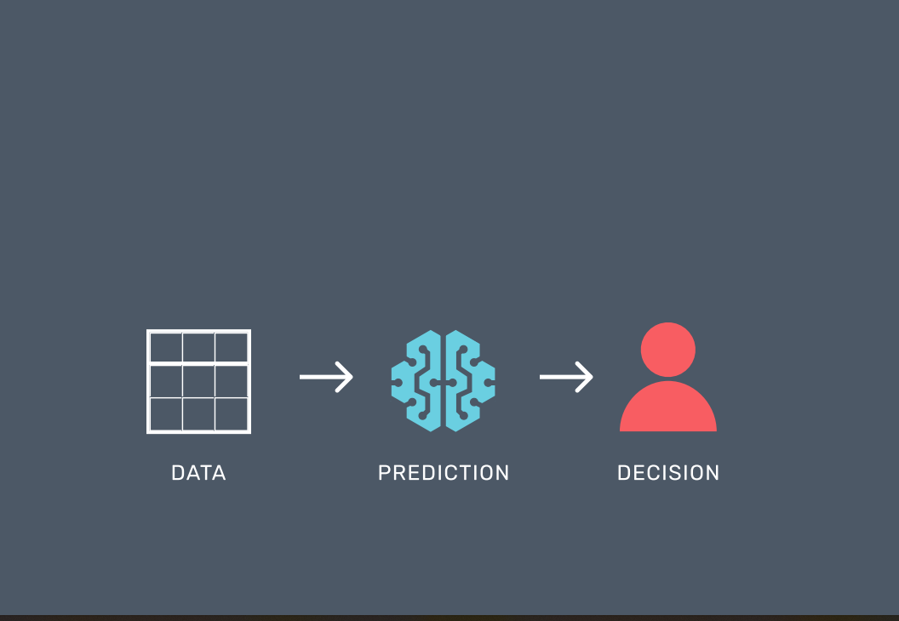

Slide 3




Slide 4
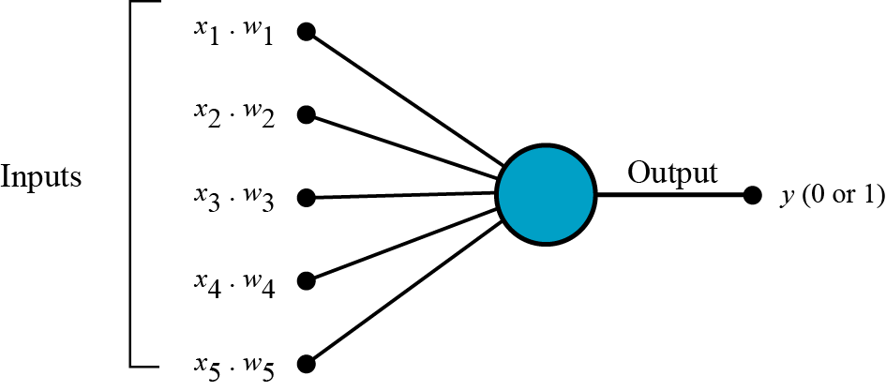
INTUITION

Slide 5



Slide 6

NEURAL NETWORK

Slide 7



Slide 8
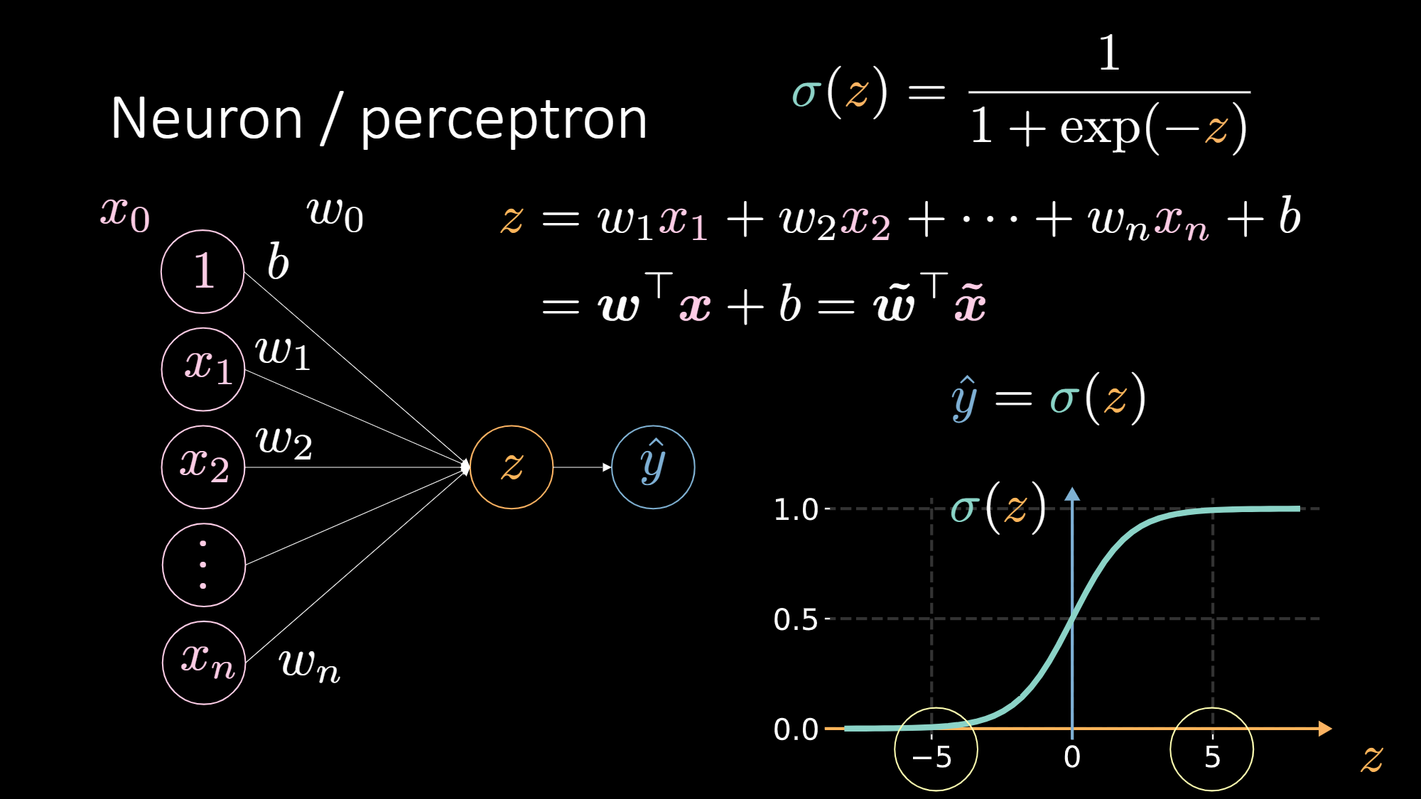

Slide 9
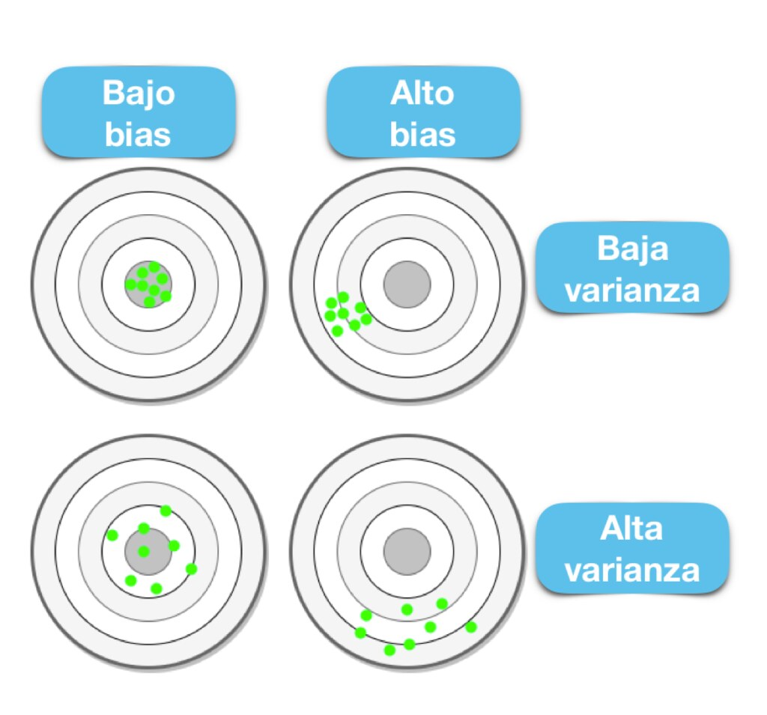
BIAS
Machine learning bias is a term used to describe when an algorithm produces results that are not correct due to some inaccurate assumptions made during one of the steps of the machine learning process.

Slide 10
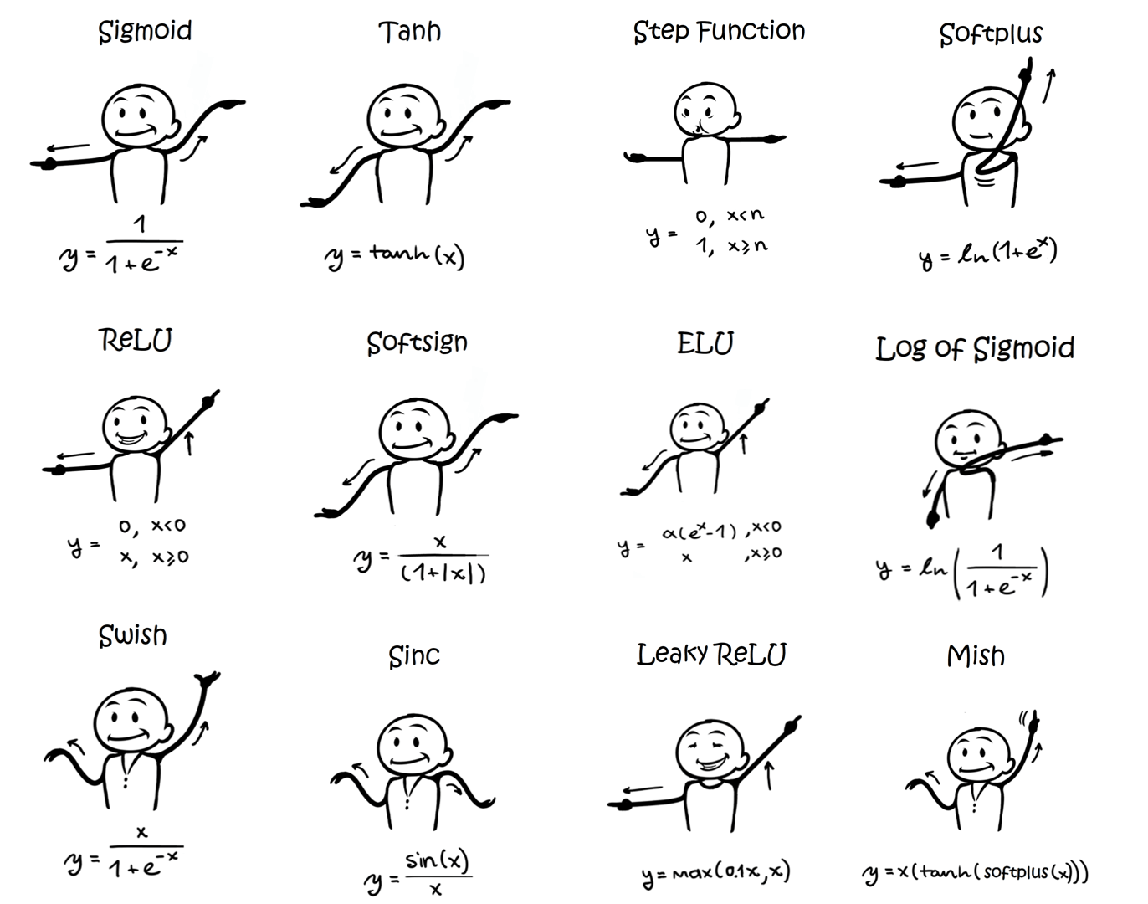
ACTIVATION FUNCTION

Slide 11
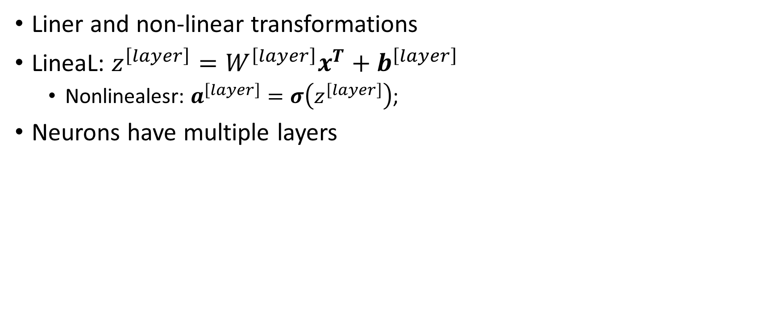
NEURAL NETWORK
Liner and non-linear transformations
LineaL: $z^{\left[layer\right]}=W^{\left[layer\right]}x^{T}+b^{\left[layer\right]}$
Nonlinealesr: $a^{\left[layer\right]}=σ\left(z^{\left[layer\right]}\right)$;
Neurons have multiple layers
Transform raw vector x in Good features

Slide 12
No linearity
ReLU idea here: Dibujar dos lineas y capturar
La intersección

Slide 13
More neurons: more complex decision surface
model = nn.Sequential(
nn.Linear(2, 10),
nn.Sigmoid(),
nn.Linear(10, 1),
nn.Sigmoid()
)
Likely overfit

Slide 14
Too much parameter=Overfitting
model = nn.Sequential(
nn.Linear(1, 1000),
nn.ReLU(),
nn.Linear(1000, 1)
)

Slide 15





Slide 16
Training process
1Prepare data
2.Normalize variable
3.One hot encoding.

Slide 17
Training process
4.Divide data on train and test set
5.Select and arquitecture and a loss function
6.Select parameters such as dropout rate.

Slide 18
Training process
Select number of epoch
Repeat step 3-5
Run training cycle (until the validation error increases or the number of epochs

Slide 19
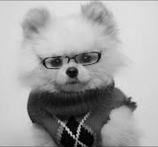
Why not use FC for images?
Flatten
Matmul
Output class
Learned weights
32 x 32
1024
1024 x 10
10

Slide 20
Convolutional filters
Flatten
Dot product
Output
5 x 5 patch
32 x 32 x 1
25
25 x 1
1

Slide 21
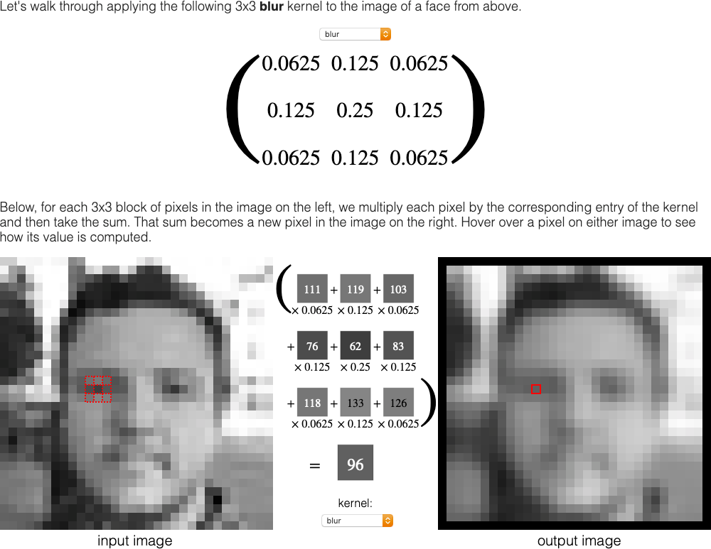
What can a conv filter do?
Instead of hard-coding the weights, we can learn them!
https://setosa.io/ev/image-kernels/

Slide 22
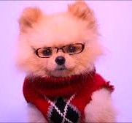
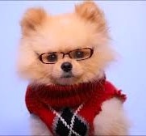
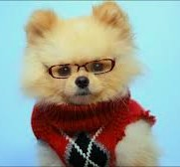
Input can have multiple channels
Flatten
Matmul
Output class
32 x 32 x 3
3072
3072 x 10
10

Slide 23
Strides
Conv2D
Filter = (3, 3)
Stride = (2, 2)

Slide 24
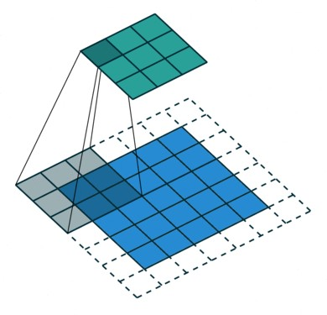
Padding
Padding resuelve el problema de filtros duera de la imagen
Done by adding extra rows/cols to the input (usually set to 0)
‘SAME’ padding esta en la imagen filter=(3,3) with stride=(2,2)
Not padding = ‘VALID’ padding
https://github.com/vdumoulin/conv_arithmetic

Slide 25
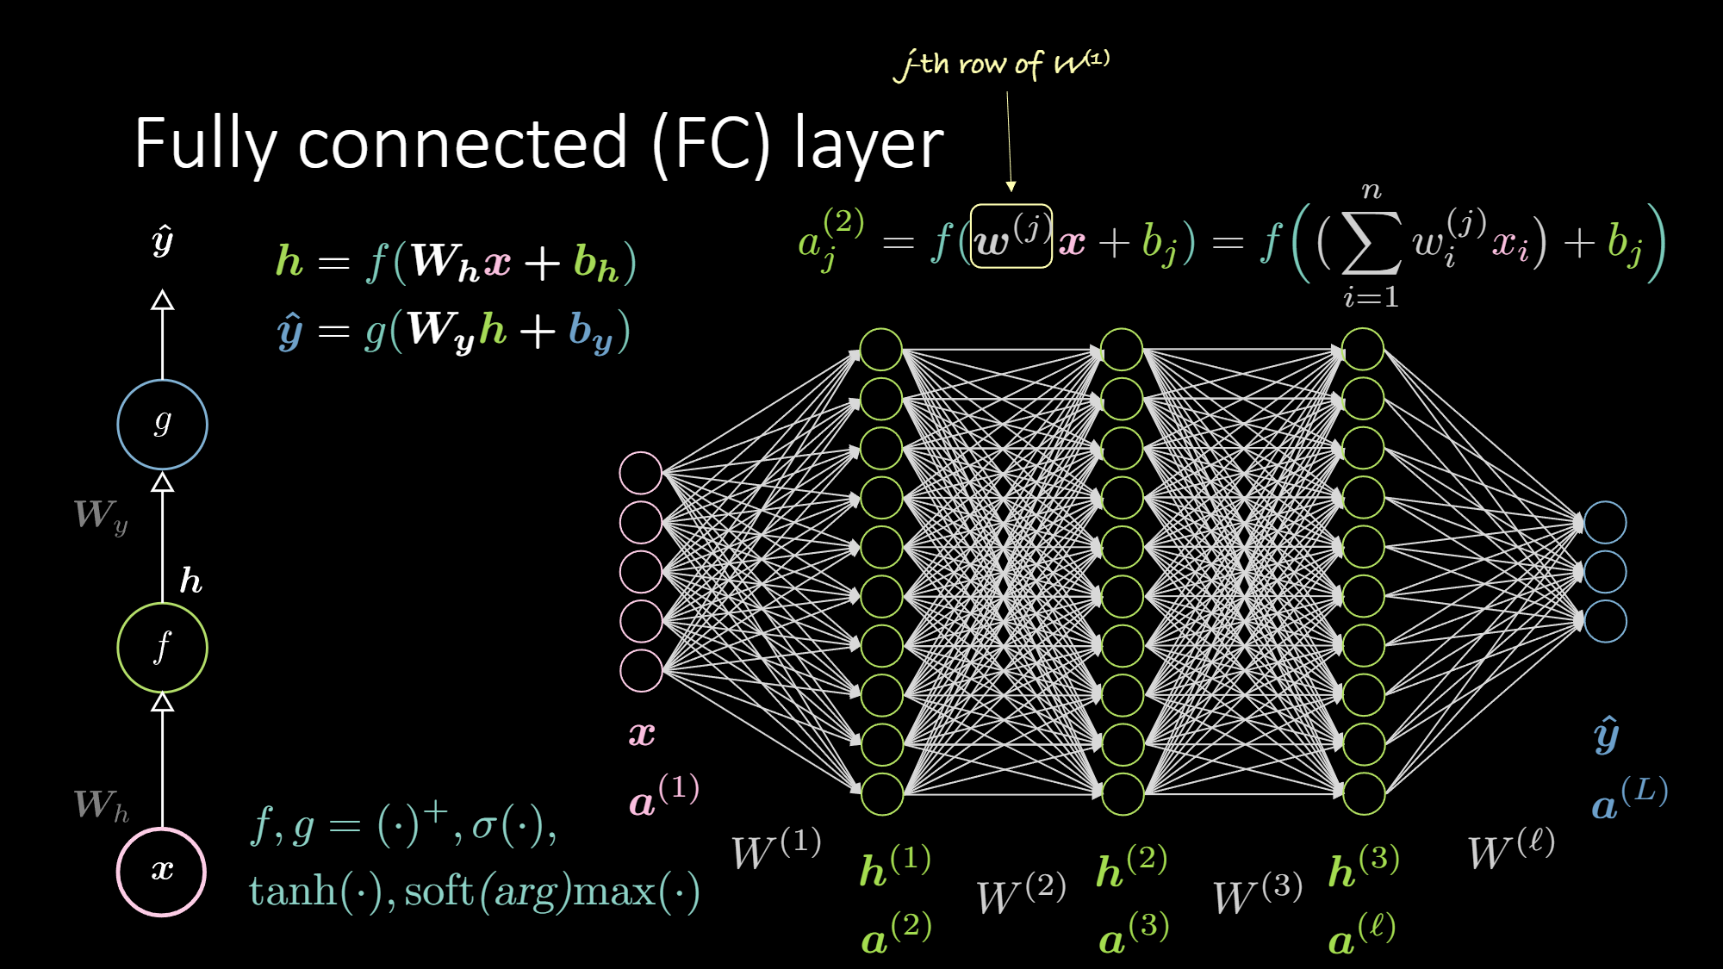

Slide 26
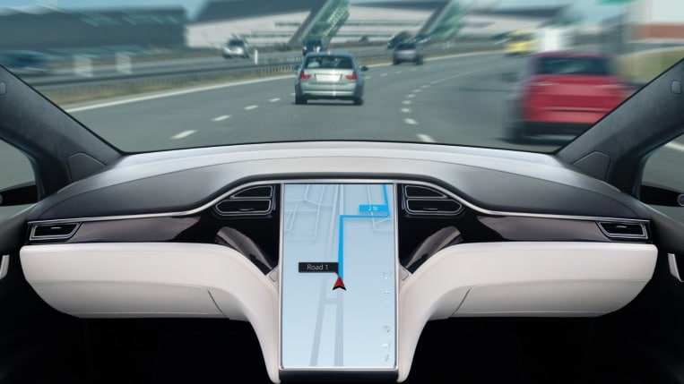
Carros autonomos

Slide 27
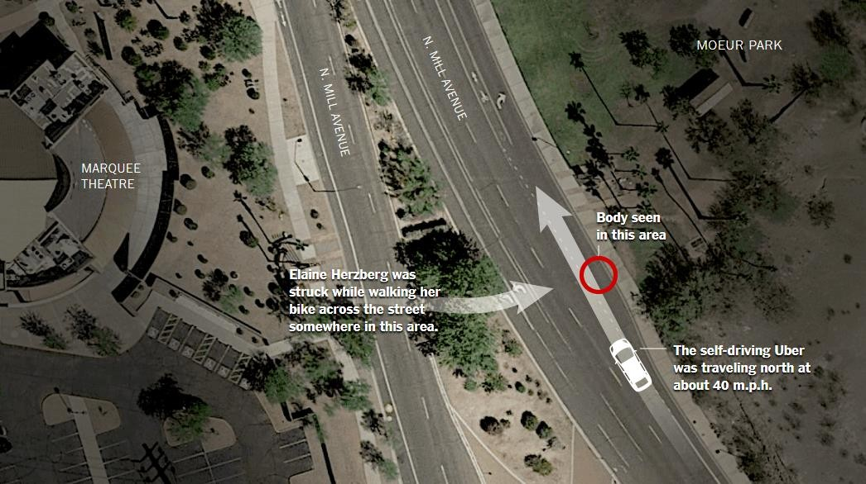
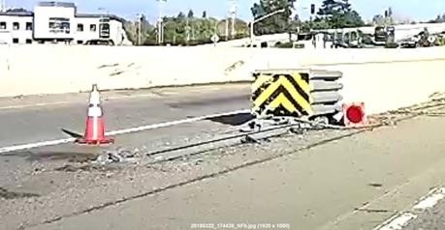
Accidentes con autos autonomos
Uber (L3/L4)
Pedestrian fatality
Tempe, Arizona
Mar 18, 2018
Tesla Autopilot (L2)
Driver fatality
Mountain View, California
Mar 23, 2018

Slide 28
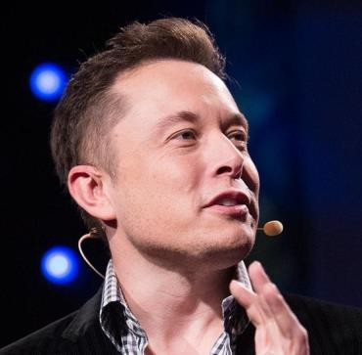
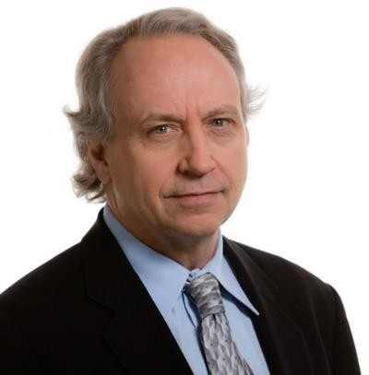
Elon Musk, Tesla
February 2017: "My guess is that in probably 10 years it will be
very unusual for cars to be built that are not fully autonomous.“
February 2018: “The upcoming autonomous coast-to-coast drive
will showcase a major leap forward for our self-driving
technology.”
Rodney Brooks
=2031: A major city bans manually driven cars from a non-
trivial portion of a city.
>2045: Majority of US cities ban manually driven cars with drivers from a non-trivial portion of a city.

Slide 29
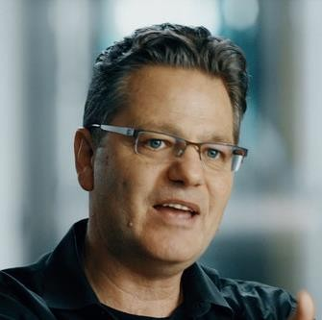
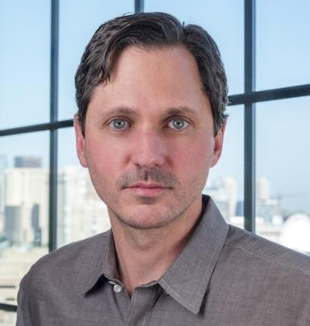
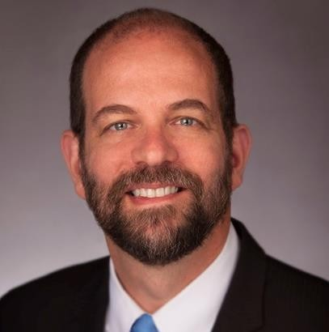
Maarten Sierhuis Director, Nissan R&D
January 2017
“We will always need the human in the loop."
Karl Iagnemma President, Aptiv Autonomous Mobility
January 2017
"(Teleoperation) is going to be massively important. Even cars that can handle just about anything will have the occasional failure, even if that's being hit by another vehicle. And in that case, you want a human around to decide what to do."
Gill Pratt, Toyota Research Institute
January 2017
“None of us in the automobile or IT industries are close to
achieving true Level 5 autonomy, we are not even close.”

Slide 30
SOPORTE DE CONTROLADORES
Driver support technology reduces the workload on the controller. Today, most automakers sell various driver support systems, either as standard equipment or as options in their cars.
.

Slide 31
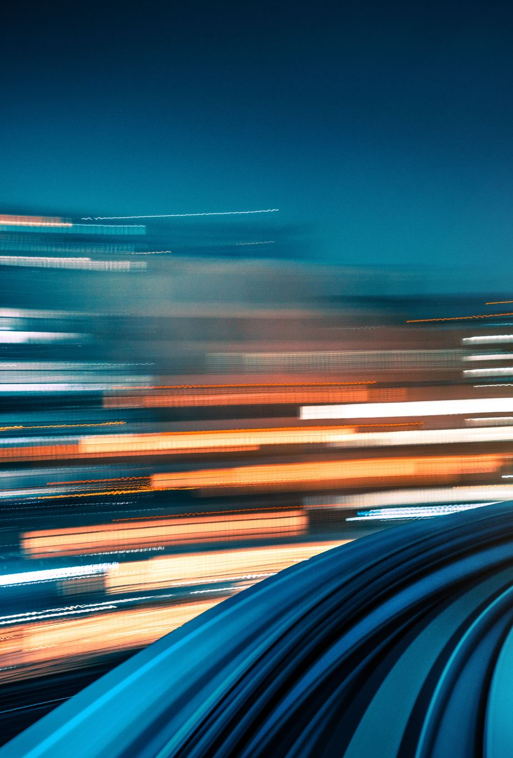
Sistemas autónomos
Los sistemas autónomos hacen la conducción por usted. Ningún fabricante de automóviles hoy en día vende un verdadero sistema autónomo, pero algunos están presionando hacia esa tecnología. U

Slide 32
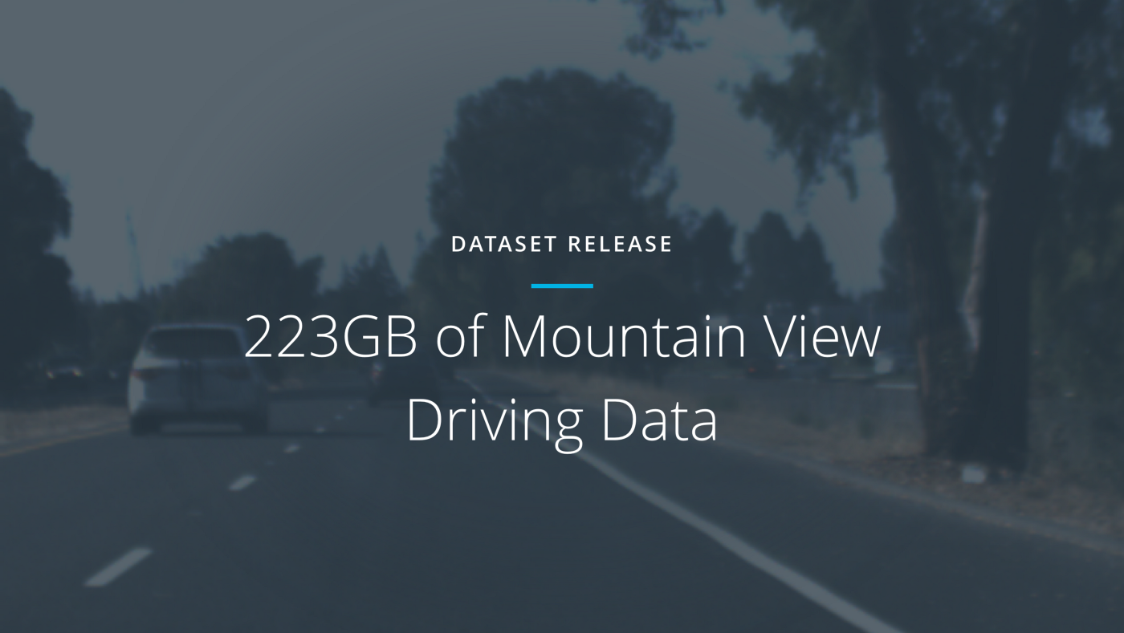
TALLER PRACTICO

Slide 33
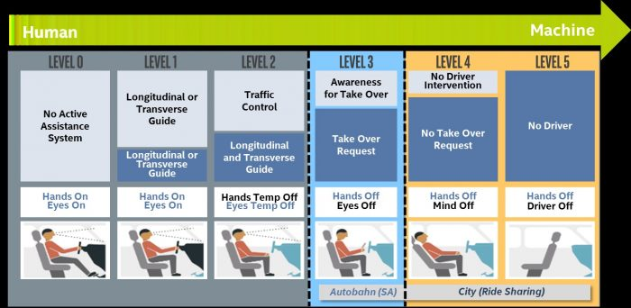
NIVELES

Slide 34
Descripción del dataset
223GB of image frames and log data from 70 minutes of driving in Mountain View on two separate days, with one sunny day and the other cloudy. Here is a sample of the record included in the dataset.
Nota: junto con un marco de imagen de nuestras cámaras, también incluimos latitud, longitud, marcha, freno, acelerador, ángulos de dirección y velocidad.
link: https://www.kaggle.com/datasets/imprime/selfdriving-car-dataset

Slide 35
